Slide 1
Exploratory Data Analysis (EDA) for Real Estate Pricing: Unveiling the Dynamics of House Valuation in a Dynamic Market
BY:PRIYANSHU KUMAR
DATE:- Feb 2025

Slide 2
Agenda
Project overview
EDA
Univariate
Multivariate
Machine learning model selection
Machine learning model creation
Final machine Learning model creation

Slide 3
Project Overview
The goal of this project is to predict house prices based on various features like lot size, number of rooms, quality, and other housing attributes. Using machine learning models, we analyze historical housing data to build an accurate price prediction system..

Slide 4
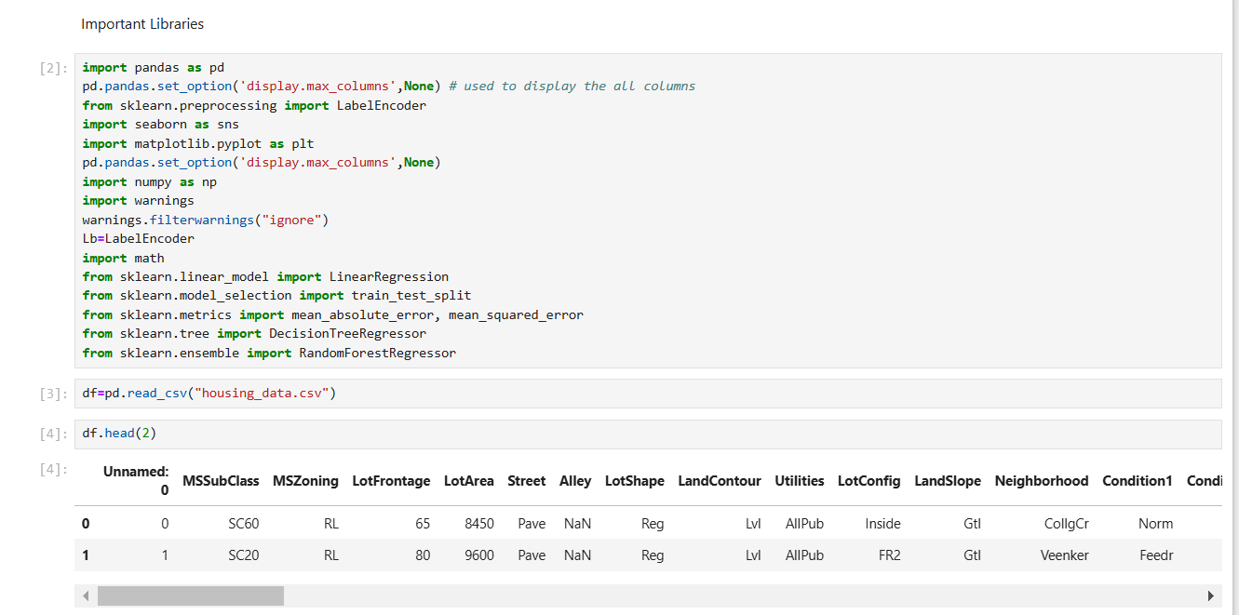
EDA
Importing libraries and loading dataset

Slide 5
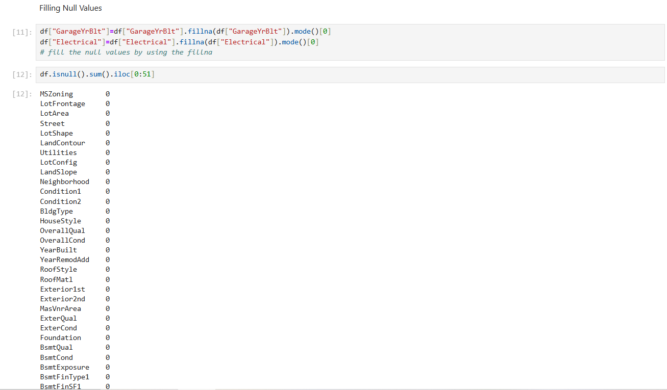
EDA
Filling the null values

Slide 6
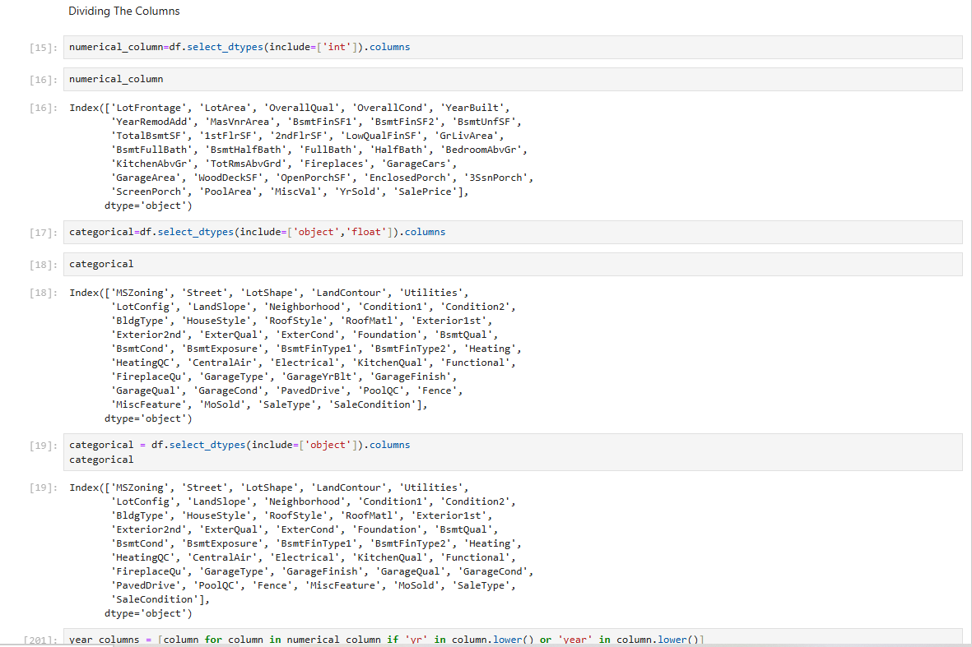
EDA
Dividing the columns into Numerical , Categorical and Year

Slide 7
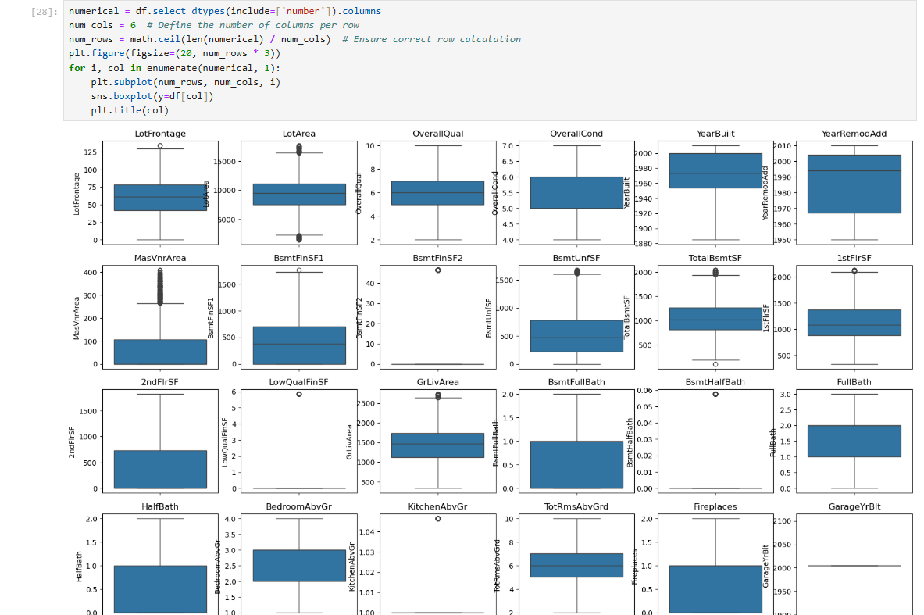
EDA
Finding the outliers

Slide 8
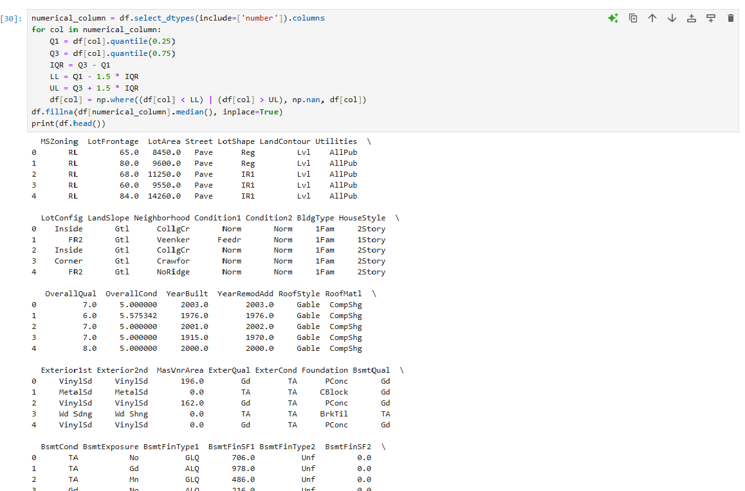
EDA
Removing the outliers

Slide 9
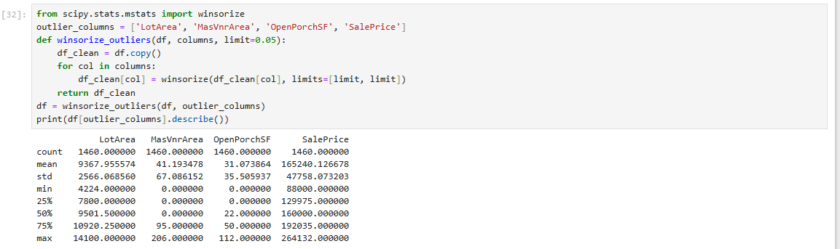
EDA
Again removing the outliers only for those columns which outliers are not removed

Slide 10
Univariate Analysis
Univariate analysis is the statistical analysis of a single variable (one feature at a time). "Uni" means
one, so we examine one column/feature in a dataset to understand its distribution, central tendency, and
variability.
we use it to :- 1. Understand the Data Distribution 2. Identify Outliers 3. Detect Missing or Invalid Data
4. Choose the Right Data Transformation 5. Feature Engineering
Following are the steps to perform the univariate analysis are :-
Understanding Data Types (Numerical vs. Categorical)
2. Univariate analysis for numerical variable
For numerical features, we analyze distribution, outliers, and summary statistics.
Summary Statistics (Mean, Median, Std)
Visualization:- Histogram(for distribution) , Boxplot(For outlier) , KDE Plot(For density)
3. Univariate analysis for categorical column
4. Handling outliers and skewness

Slide 11
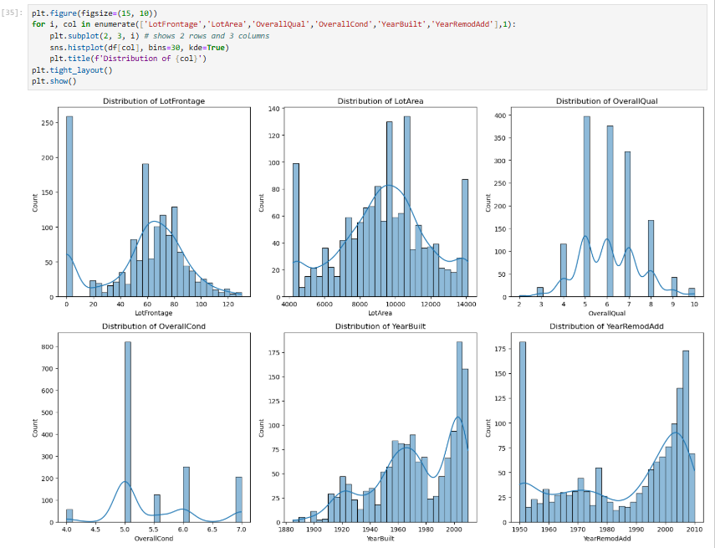
Univariate analysis
Here it shows the distribution and skewness

Slide 12
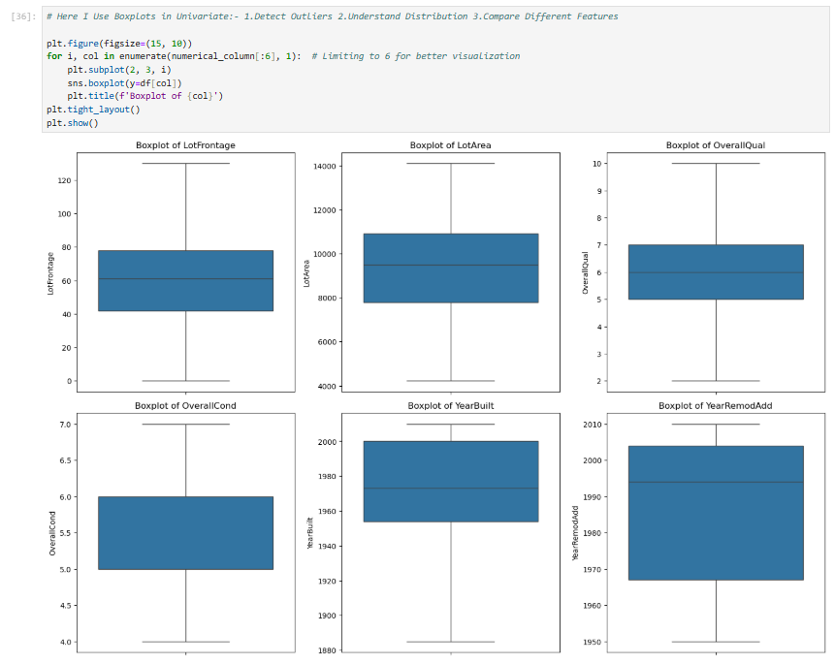
Univariate analysis
Here I Use Boxplots to:- 1.Detect Outliers 2.Understand Distribution 3.Compare Different Features

Slide 13
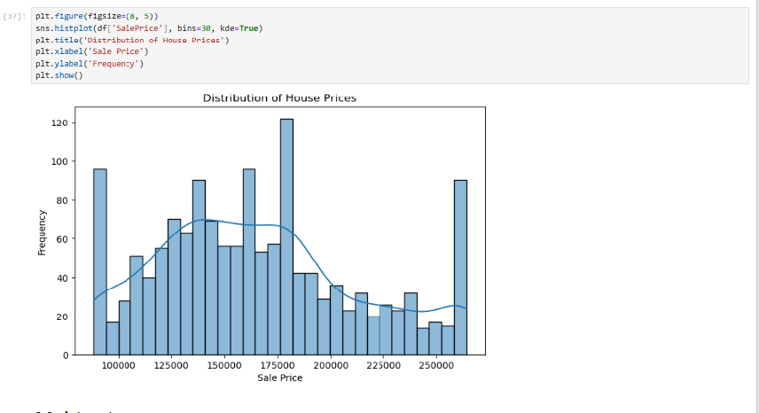
Univariate analysis
Histograms/KDE plots reveal skewness and normality.

Slide 14
Multivariate analysis
IT is a statistical technique used to analyze multiple variables at the same time. It helps in understanding
relationships, patterns, and dependencies between different features in a dataset.
we use it to:- 1. Detect Relationships Between Features
2. Identify Feature Importance for Prediction Models
3. Detect Multicollinearity (Highly Correlated Features)
4. Find Hidden Patterns in Data
5. Improve Machine Learning Model Performance
Common Techniques for Multivariate Analysis are:-
1. Correlation Heatmap (Detects Feature Relationships)
2. Pairplot (Visualizing Multiple Variables Together)
3. Principal Component Analysis (PCA - Dimensionality Reduction)

Slide 15
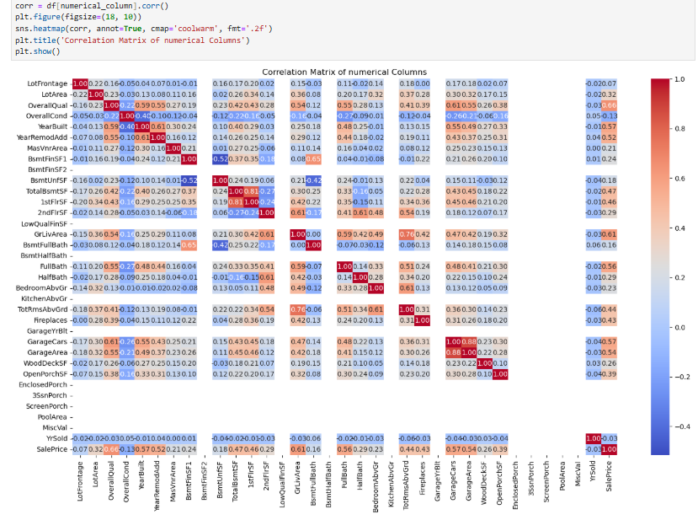
Multivariate analysis
Here I use the correlation matrix between the numerical column so that I can remove those columns which are not correlated with any of the column.

Slide 16
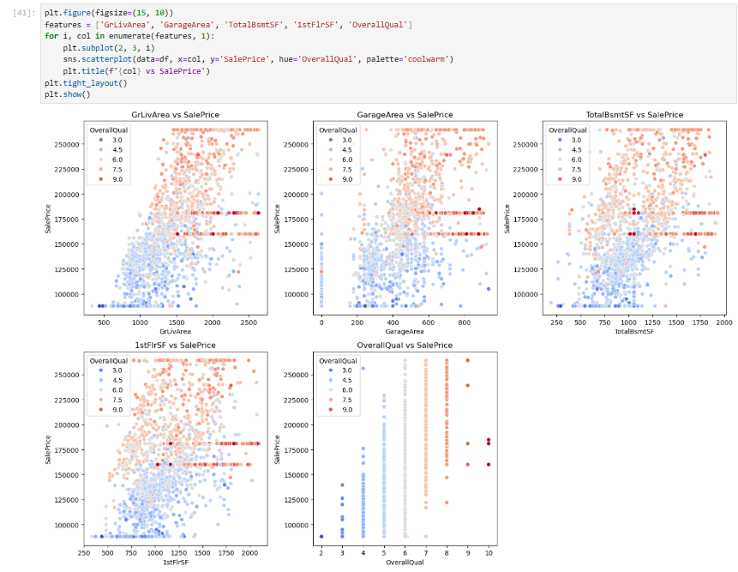
Multivariate analysis
Use scatter plot to visualize the relationship between the two numerical variable .

Slide 17
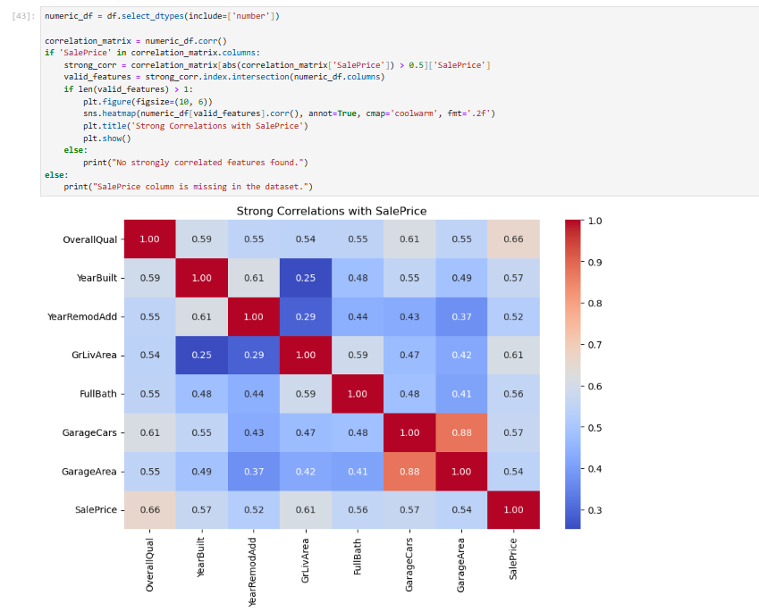
Multivariate analysis
Finding the correlation with the sales price.

Slide 18
Feature engineering
Feature Engineering is the process of transforming raw data into meaningful features that improve the performance of a machine learning model. It involves selecting, modifying, or creating new features from existing data to enhance the model’s predictive power.
we use feature engineering to:-
1.Improves Model Accuracy
2.Reduces Overfitting & Underfitting
3.Handles Missing or Noisy Data
4.Transforms Data for Better Learning
5.Creates New Meaningful Features

Slide 19
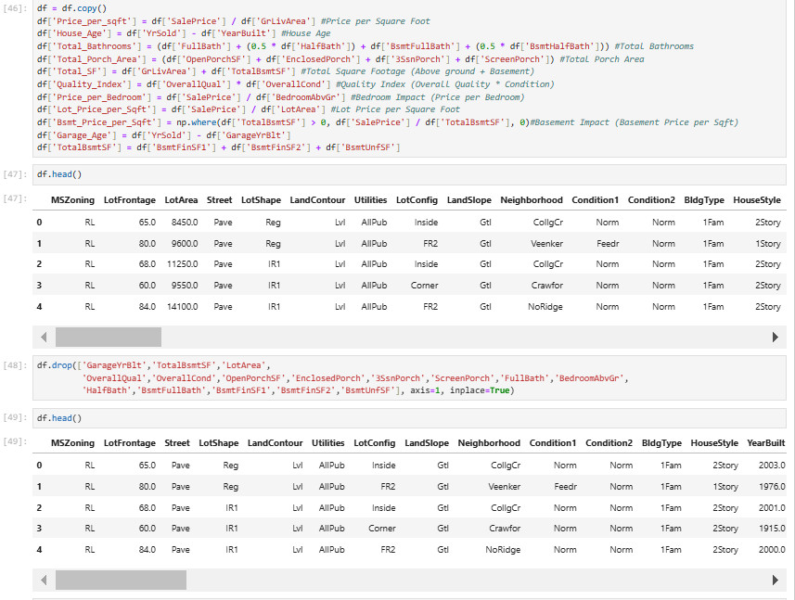
Feature engineering
Create new column by using the other column which related with it and drop those columns which are used in creating new column.

Slide 20
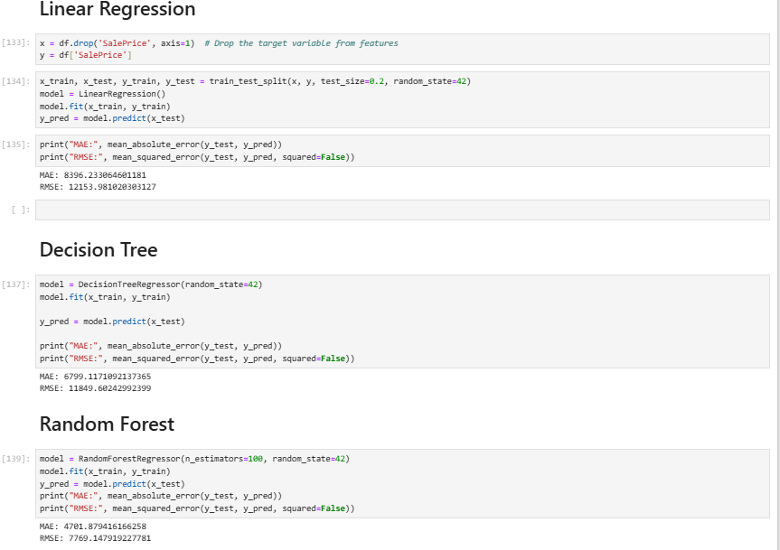
ML model selection
Machine Learning Model Selection is the process of choosing the best algorithm to solve a given problem based on factors like dataset size, feature types, computational efficiency, and performance metrics. The goal is to find the most accurate and efficient model for the task.

Slide 21
ML model creation
I am using the random forest because on comparing the MAE and RMSE of all the three model the MAE and RMSE of random forest is small.
RMSE:- It stands for Root Mean Squared Error. It is a widely used performance metric for regression models. It measures the difference between the predicted values (y hat) and actual values (y) in a dataset.
MAE:- It stands for Mean Absolute Error. Is a metric used to measure the average absolute differences between actual and predicted values in regression models.
(n_estimators=100, random_state=42):-
n_estimators=100:- (Number of trees)This defines the number of decision trees in the Random Forest . A higher value generally leads to better accuracy but increases computational cost. When it is to low the model is under fit and when it is to high there is no major improvement, just slows down training.
random_state=42:- It Ensures that every time you train the model, you get the same results.

Slide 22
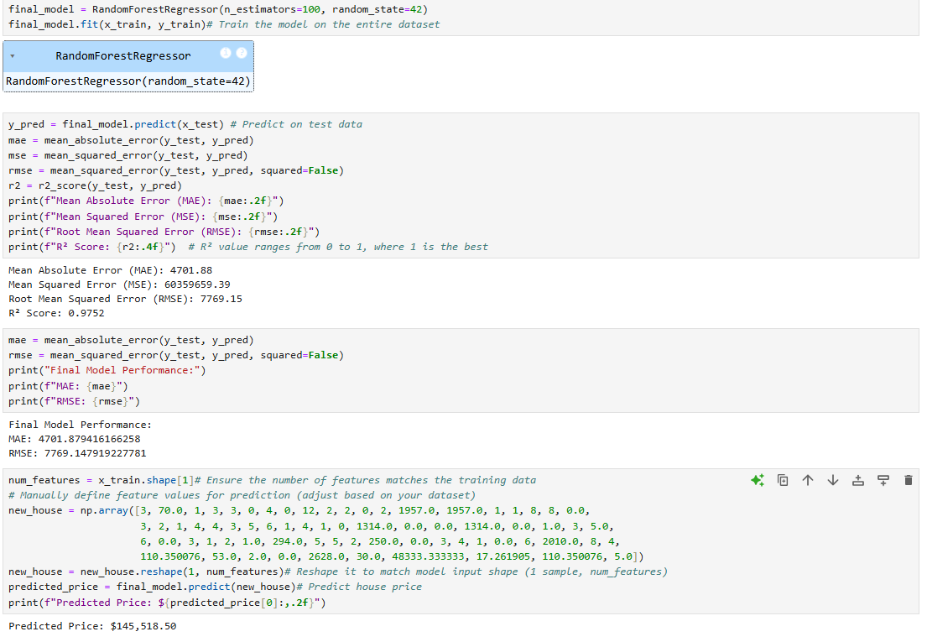
ML model creation

Slide 23
Thankyou

